Slide 1
natal
mariana
3°A
11
ADRIANA

Slide 2


Slide 3
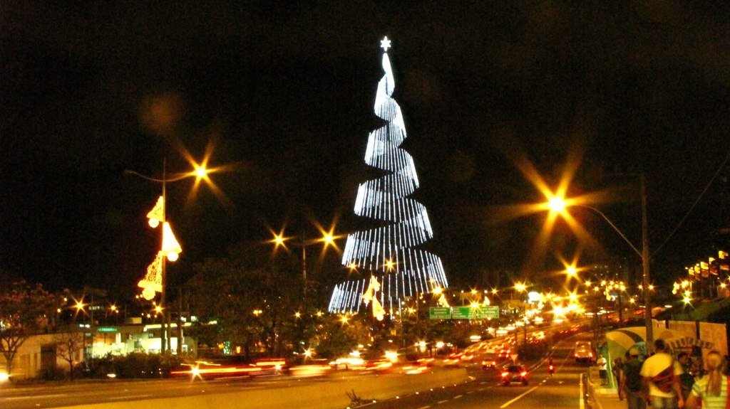

Slide 4


Slide 5


Slide 6


Slide 7
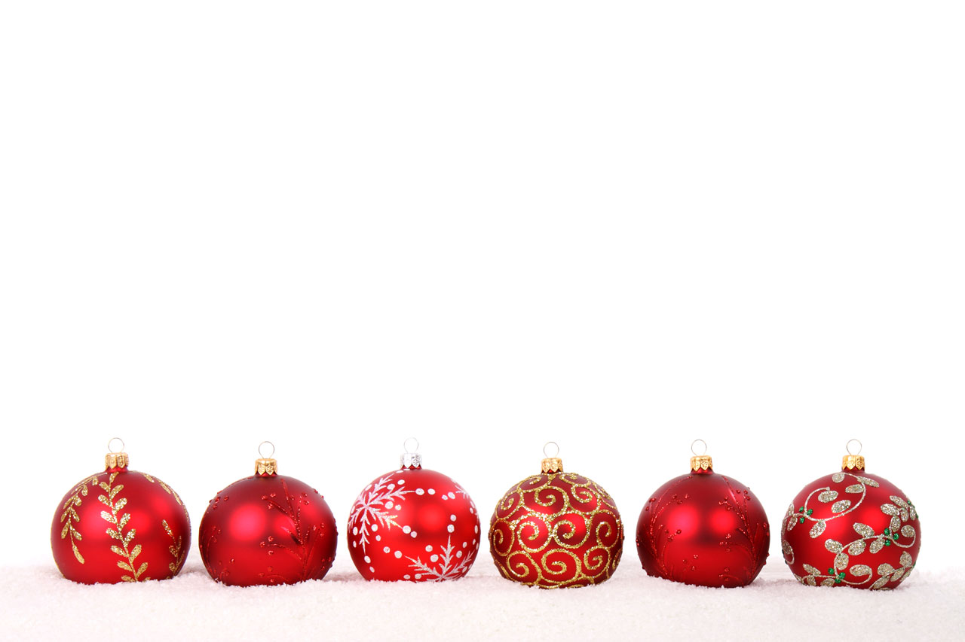

Slide 9
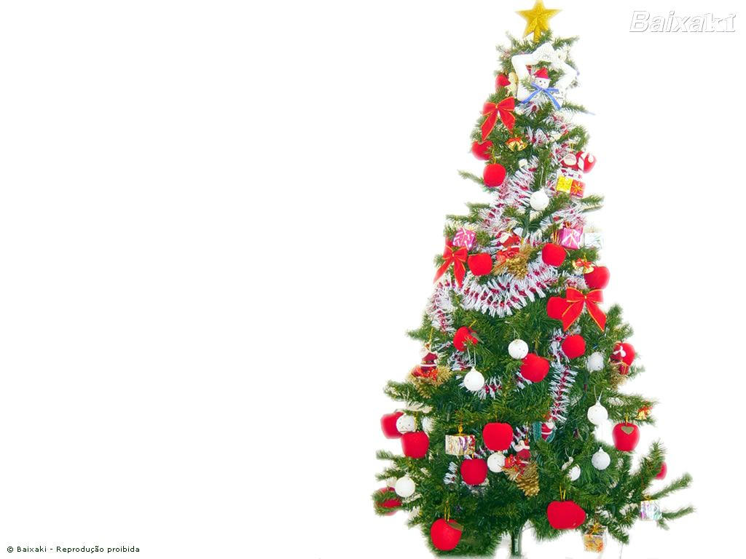

Slide 10


