Slide 1
mata atlantica
agatha

Slide 2
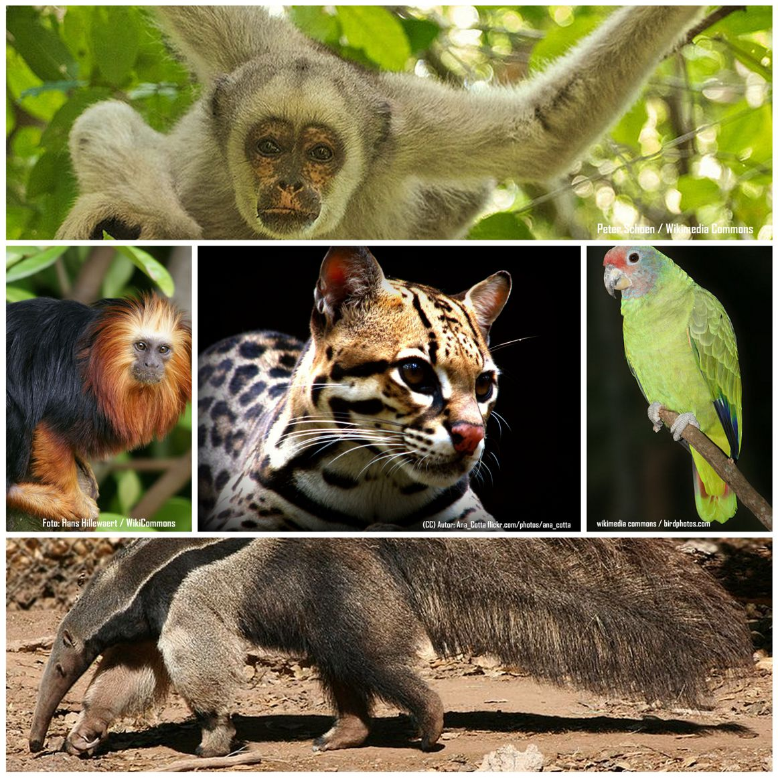
Mata atlantica

Slide 3
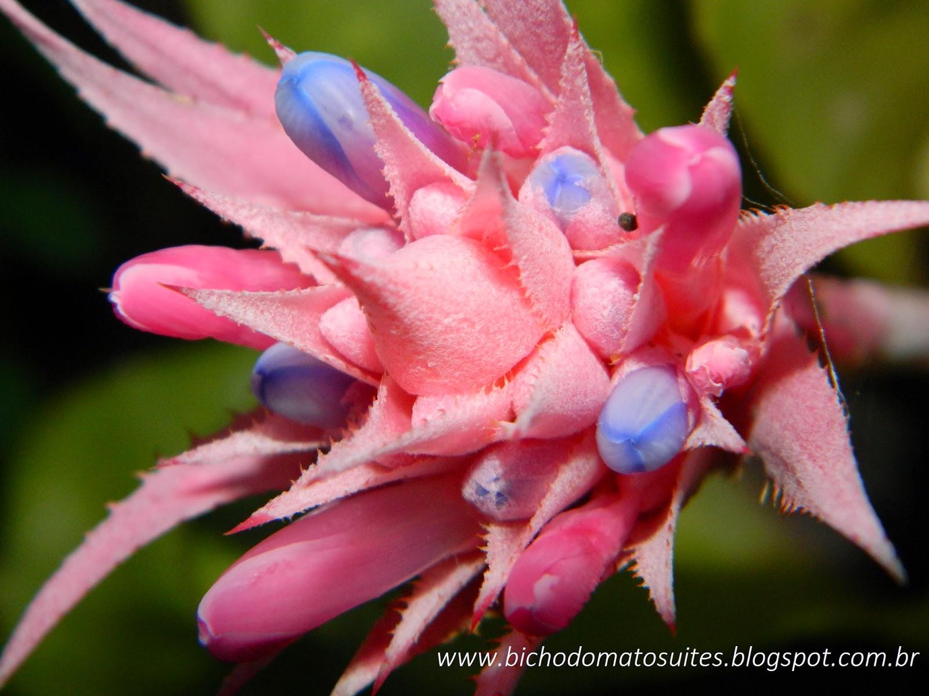

Slide 4
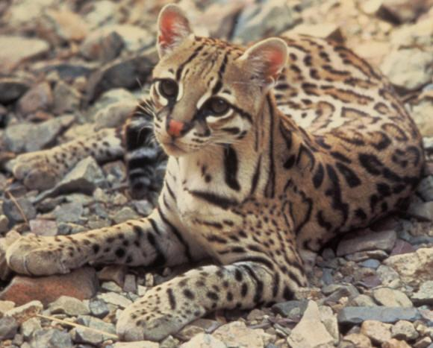

Slide 5
